Slide 1
Chapter 3: Principles of Scalable Performance
Performance measures
Speedup laws
Scalability principles
Scaling up vs. scaling down
EENG-630 Chapter 3
1

Slide 2
Performance metrics and measures
Parallelism profiles
Asymptotic speedup factor
System efficiency, utilization and quality
Standard performance measures
EENG-630 Chapter 3

Slide 3
Degree of parallelism
Reflects the matching of software and hardware parallelism
Discrete time function – measure, for each time period, the # of processors used
Parallelism profile is a plot of the DOP as a function of time
Ideally have unlimited resources
EENG-630 Chapter 3

Slide 4
Factors affecting parallelism profiles
Algorithm structure
Program optimization
Resource utilization
Run-time conditions
Realistically limited by # of available processors, memory, and other nonprocessor resources
EENG-630 Chapter 3

Slide 5
Average parallelism variables
n – homogeneous processors
m – maximum parallelism in a profile
Δ - computing capacity of a single processor (execution rate only, no overhead)
DOP=i – # processors busy during an observation period
EENG-630 Chapter 3

Slide 6
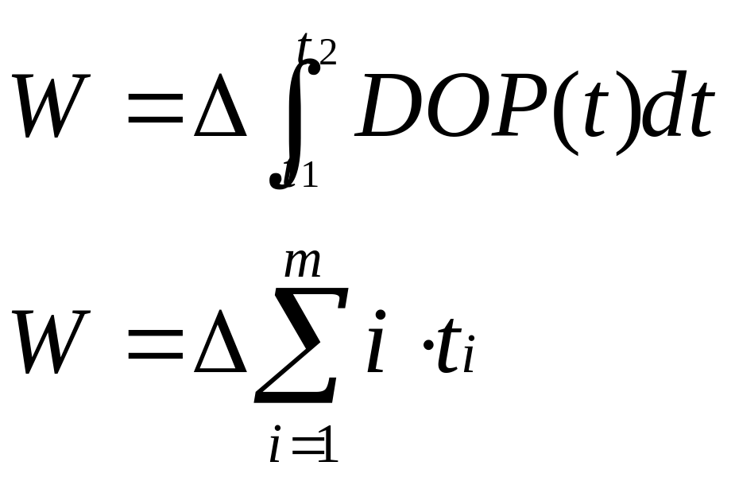
Average parallelism
Total amount of work performed is proportional to the area under the profile curve
EENG-630 Chapter 3

Slide 7
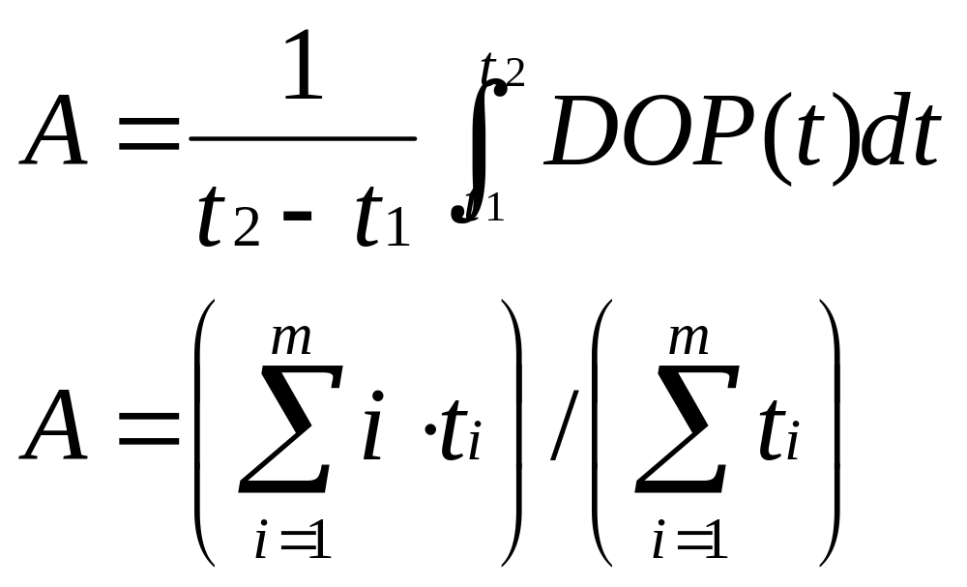
Average parallelism
EENG-630 Chapter 3

Slide 8
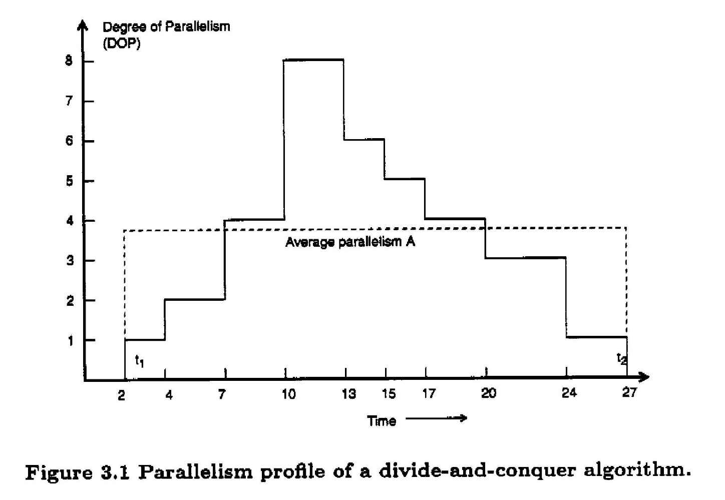
Example: parallelism profile and average parallelism
EENG-630 Chapter 3

Slide 9
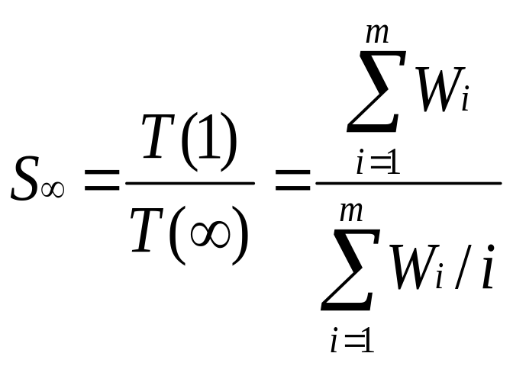
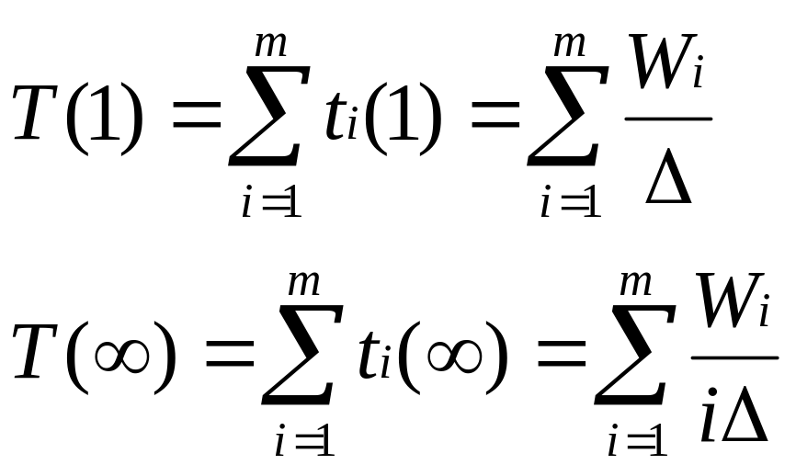
Asymptotic speedup
= A in the ideal case
(response time)
EENG-630 Chapter 3

Slide 10
Speedup
The speed of a program is the time it takes the program to execute
Speedup is defined as the time it takes a program to execute in serial (with one processor) divided by the time it takes to execute in parallel (with many processors)
S=T(1)/T(j), Where T(j) is the time it takes to execute the program when using j processors
Efficiency is the speedup, divided by the number of processors used
EENG-630 Chapter 3

Slide 11
Performance measures
Consider n processors executing m programs in various modes
Want to define the mean performance of these multimode computers:
  Arithmetic mean performance
  Geometric mean performance
  Harmonic mean performance
EENG-630 Chapter 3

Slide 12
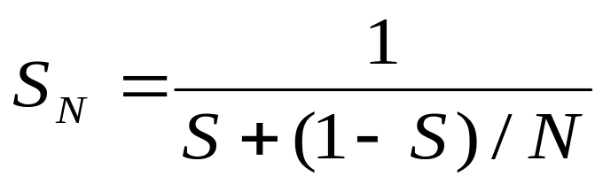
Amdahl’s Law
If S is the fraction of a calculation that is serial and 1-S the fraction that can be parallelized, then the greatest speedup that can be achieved using N processors is:
Limiting Value for S_{N} is 1/S
EENG-630 Chapter 3

Slide 13
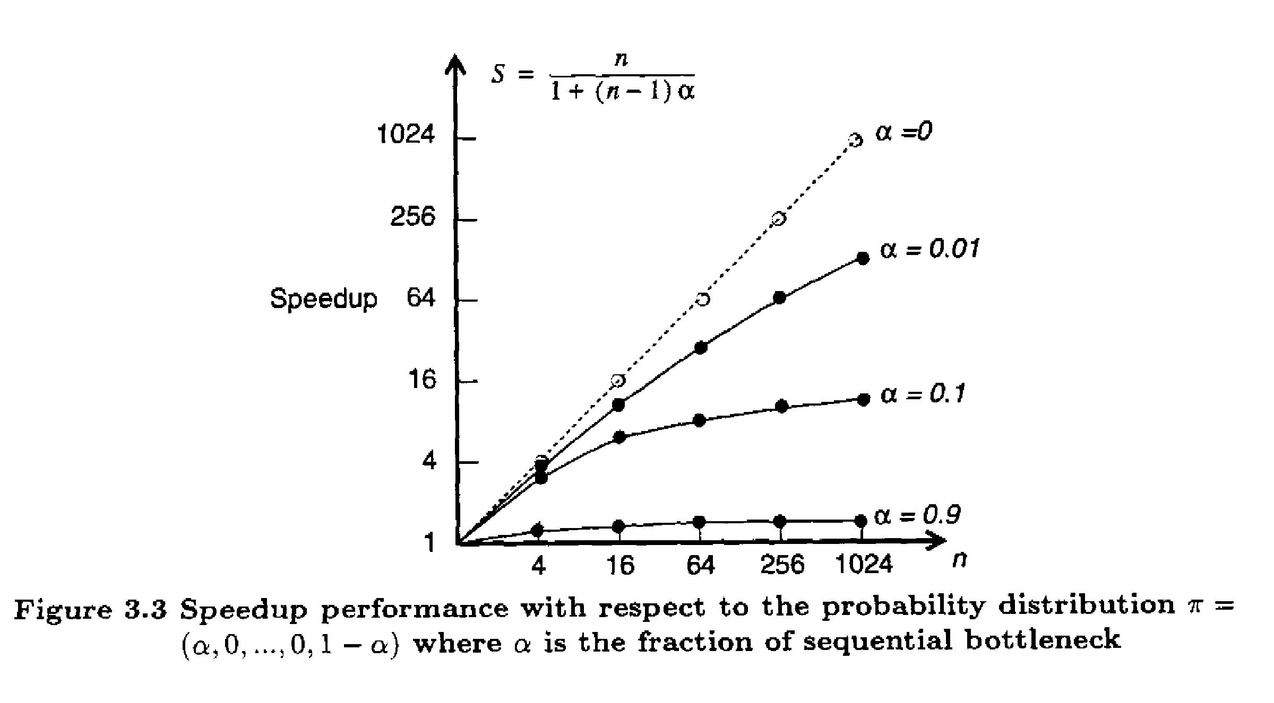
Speedup Performance
EENG-630 Chapter 3

Slide 14
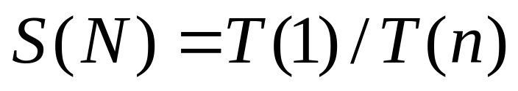
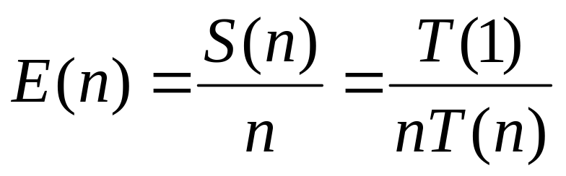
System Efficiency
O(n) is the total number of unit operations performed by N processor system
T(n) is execution time in unit time steps
T(n) < O(n) and T(1) = O(1)
EENG-630 Chapter 3

Slide 15
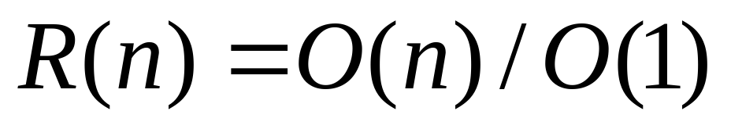
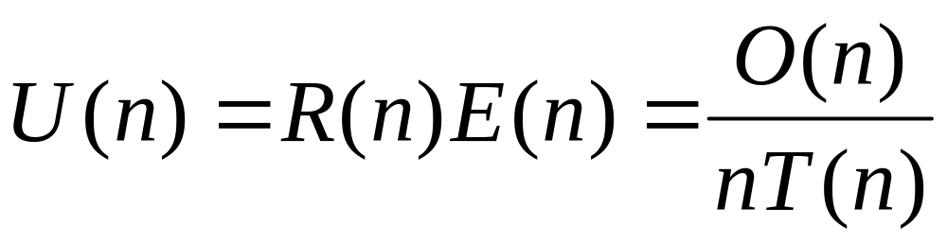
Redundancy and Utilization
Redundancy signifies the extent of matching software and hardware parallelism
Utilization indicates the percentage of resources kept busy during execution
EENG-630 Chapter 3

Slide 16
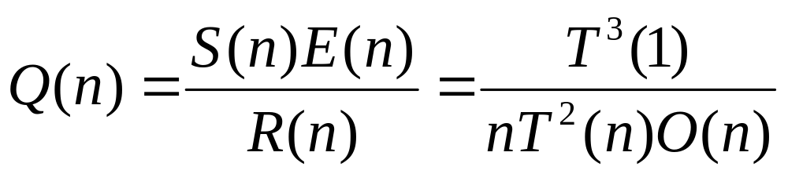
Quality of Parallelism
Directly proportional to the speedup and efficiency and inversely related to the redundancy
Upper-bounded by the speedup S(n)
EENG-630 Chapter 3

Slide 17
Parallel Processing Applications
Drug design
High-speed civil transport
Ocean modeling
Ozone depletion research
Air pollution
Digital anatomy
EENG-630 Chapter 3

Slide 18
Application Models for Parallel Computers
Fixed-load model
  Constant workload
Fixed-time model
  Demands constant program execution time
Fixed-memory model
  Limited by the memory bound
EENG-630 Chapter 3

Slide 19
Parallel Algorithm Characteristics
Deterministic vs. nondeterministic
Computational granularity
Parallelism profile
Communication patterns and synchronization requirements
Uniformity of operations
Memory requirement and data structures
EENG-630 Chapter 3

Slide 20
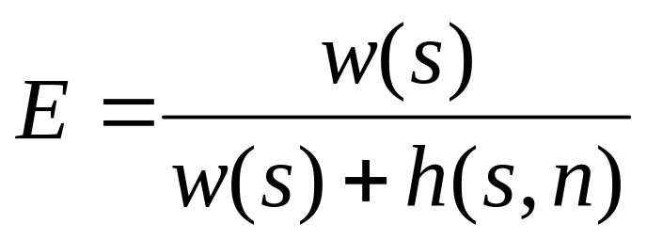
Isoefficiency Concept
Relates workload to machine size n needed to maintain a fixed efficiency
The smaller the power of n, the more scalable the system
workload
overhead
EENG-630 Chapter 3

Slide 21
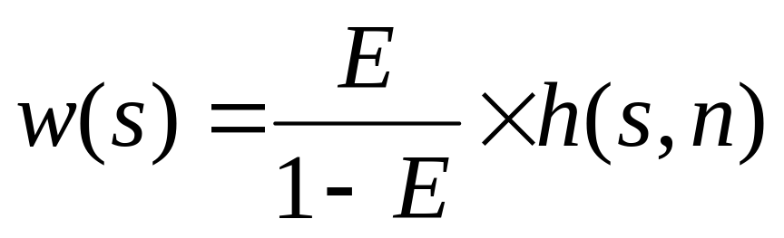
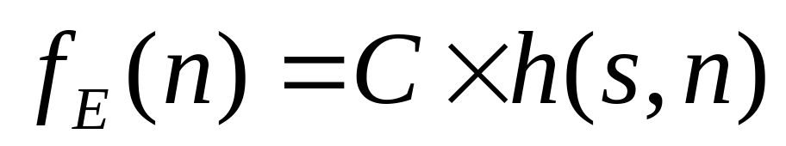
Isoefficiency Function
To maintain a constant E, w(s) should grow in proportion to h(s,n)
C = E/(1-E) is constant for fixed E
EENG-630 Chapter 3

Slide 22
Speedup Performance Laws
Amdahl’s law
  for fixed workload or fixed problem size
Gustafson’s law
  for scaled problems (problem size increases with increased machine size)
Speedup model
  for scaled problems bounded by memory capacity
EENG-630 Chapter 3

Slide 23
Amdahl’s Law
As # of processors increase, the fixed load is distributed to more processors
Minimal turnaround time is primary goal
Speedup factor is upper-bounded by a sequential bottleneck
Two cases:
  DOP < n
  DOP ≥ n
EENG-630 Chapter 3

Slide 24
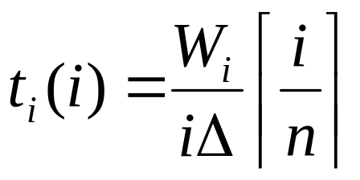
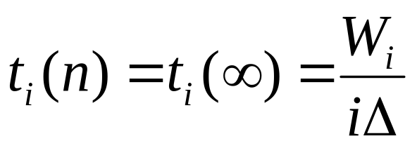
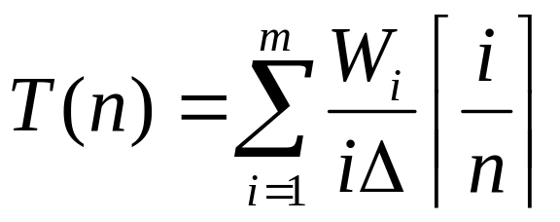
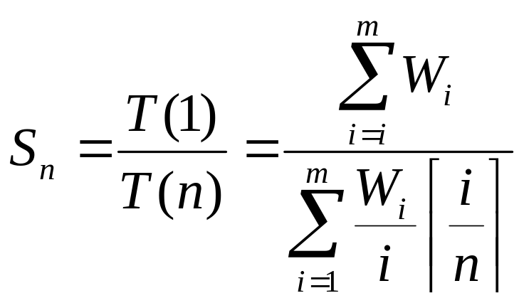
Fixed Load Speedup Factor
Case 1: DOP > n
Case 2: DOP < n
EENG-630 Chapter 3

Slide 25
Gustafson’s Law
With Amdahl’s Law, the workload cannot scale to match the available computing power as n increases
Gustafson’s Law fixes the time, allowing the problem size to increase with higher n
Not saving time, but increasing accuracy
EENG-630 Chapter 3

Slide 26
Fixed-time Speedup
As the machine size increases, have increased workload and new profile
In general, W_{i}’ > W_{i} for 2 ≤ i ≤ m’ and W₁’ = W₁
Assume T(1) = T’(n)
EENG-630 Chapter 3

Slide 27
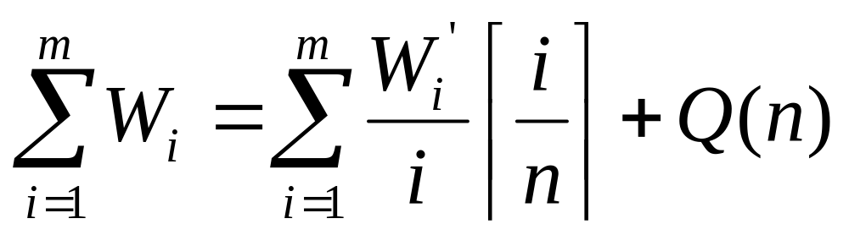
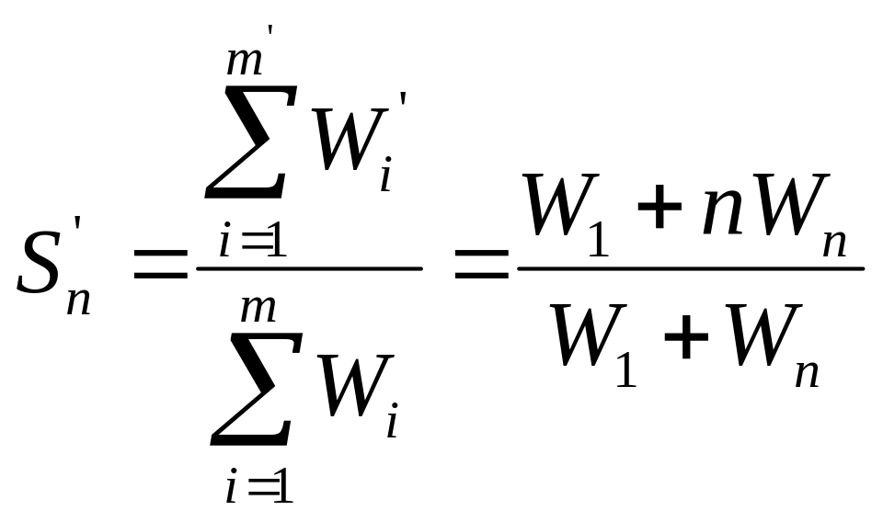
Gustafson’s Scaled Speedup
EENG-630 Chapter 3

Slide 28
Scalability Metrics
Machine size (n) : # of processors
Clock rate (f) : determines basic m/c cycle
Problem size (s) : amount of computational workload. Directly proportional to T(s,1).
CPU time (T(s,n)) : actual CPU time for execution
I/O demand (d) : demand in moving the program, data, and results for a given run
EENG-630 Chapter 3

Slide 29
Scalability Metrics
Memory capacity (m) : max # of memory words demanded
Communication overhead (h(s,n)) : amount of time for interprocessor communication, synchronization, etc.
Computer cost (c) : total cost of h/w and s/w resources required
Programming overhead (p) : development overhead associated with an application program
EENG-630 Chapter 3

Slide 30
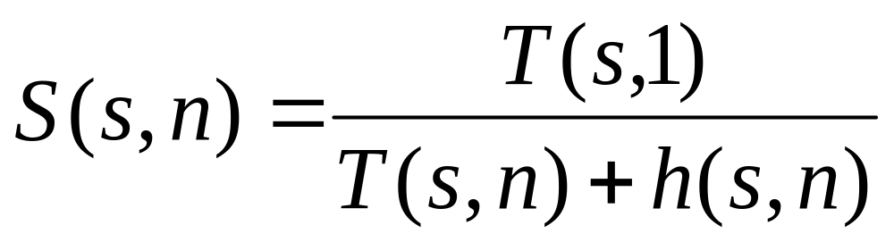
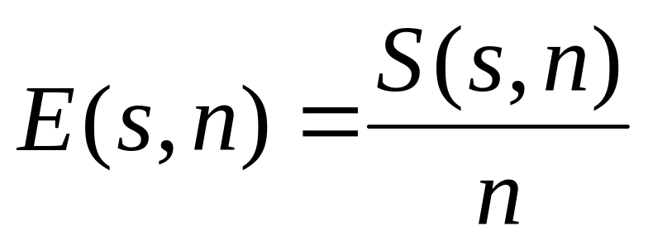
Speedup and Efficiency
The problem size is the independent parameter
EENG-630 Chapter 3

Slide 31
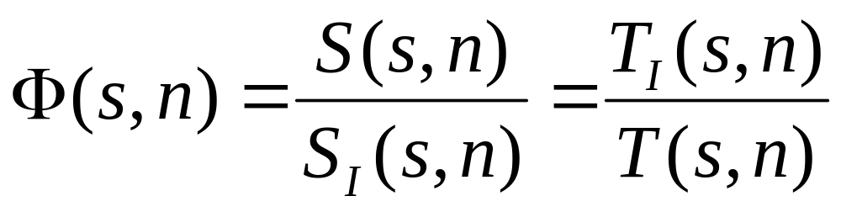
Scalable Systems
Ideally, if E(s,n)=1 for all algorithms and any s and n, system is scalable
Practically, consider the scalability of a m/c
EENG-630 Chapter 3

